Slide 1

Bank Marketing data ANALYSIS
Logistic regression

Slide 2
the data: marketing data from Kaggle
It is a dataset that describing bank marketing campaigns results. Conducted campaigns were based mostly on direct phone calls, offering a bank client to place/subscribe to a term deposit. If after all marketing efforts the client agreed to place deposit – the target variable was marked 'yes', otherwise 'no'.
The description about the campaign can be found at (https://archive.ics.uci.edu/ml/datasets/bank+marketing

Slide 3
DATA SET
age
job
marital
education
default
housing
loan
contact
month
day_of_week
duration
campaign
pdays
previous
poutcome
emp.var.rate
cons.price.idx
cons.conf.idx
euribor3m
nr.employed
y

Slide 4
Question: DRIVERS OF marketing success
What client characteristics are most significant in predicting the success of a marketing campaign for the bank?
What is their numerical impact to the probability of a yes outcome?
The response variable chosen was the column y: which is a yes/no column indicating the result of the campaign.
Possible variables were

Slide 5
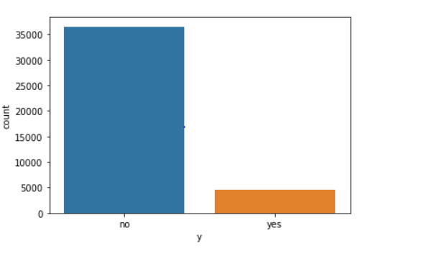
Exploratory data analysis
Distribution of y

Slide 6
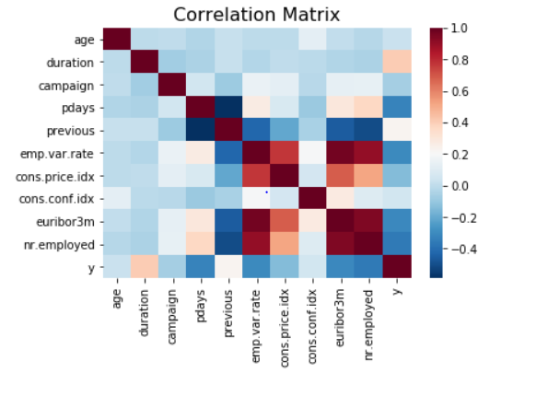
correlation

Slide 7
logistic regression
Test/Validation approach (2 models)
a.)Reducing the model - a1.from recursive selection and a2. just plain p-values of full model, compare error matrices
b.)Implementing the best model from 1
2. K-Fold cross validation approach. Algorithm splits data into k folds.
compare best model error measures with best model from 1
3.Interprating the overall best model-i.e. with least error

Slide 8
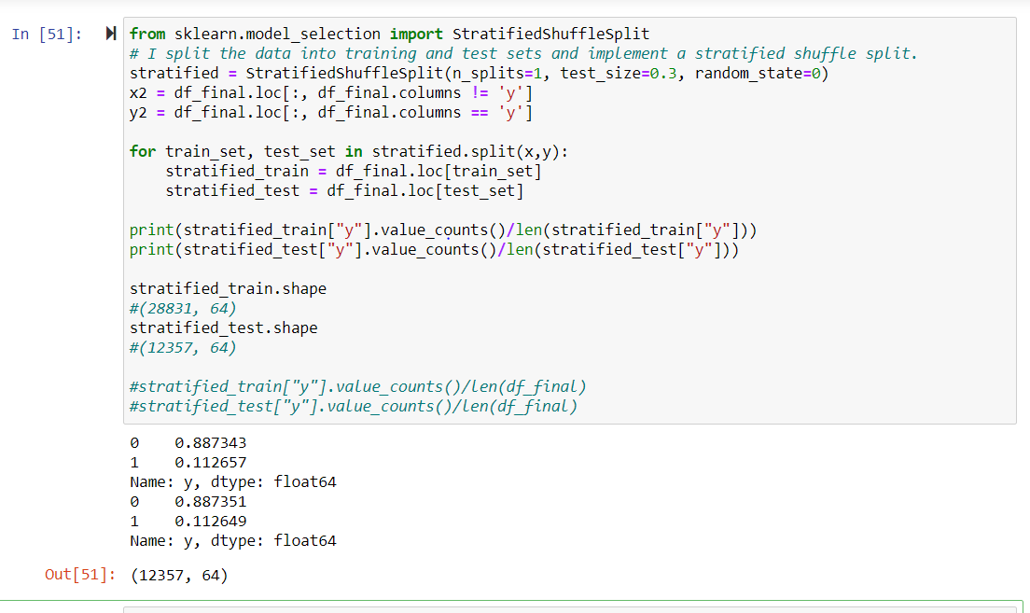
Splitting Data: Stratified sampling

Slide 9
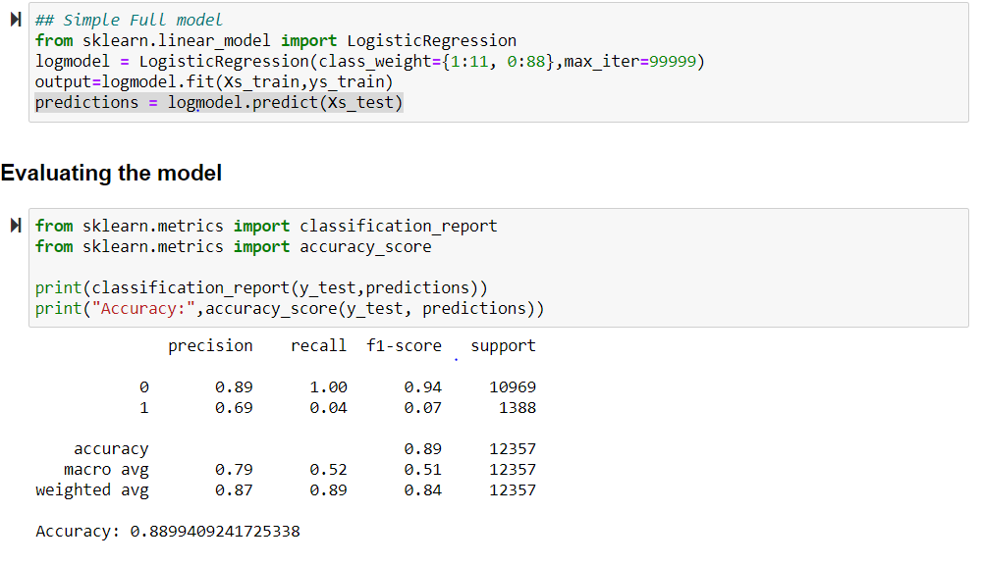
Test/Validation approach (2 models)

Slide 10
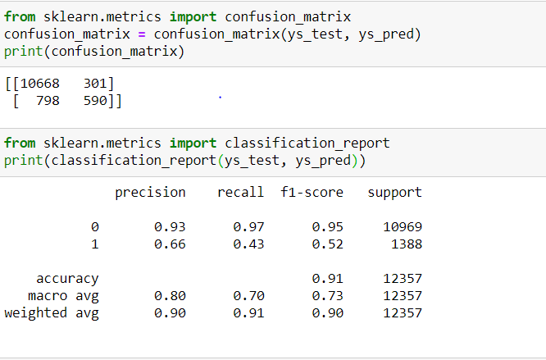
Recursive selection

Slide 11
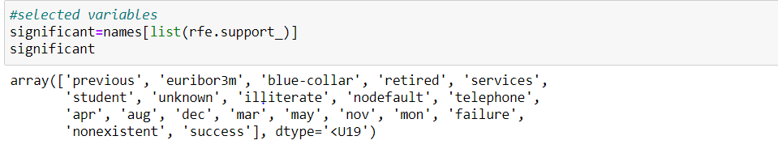
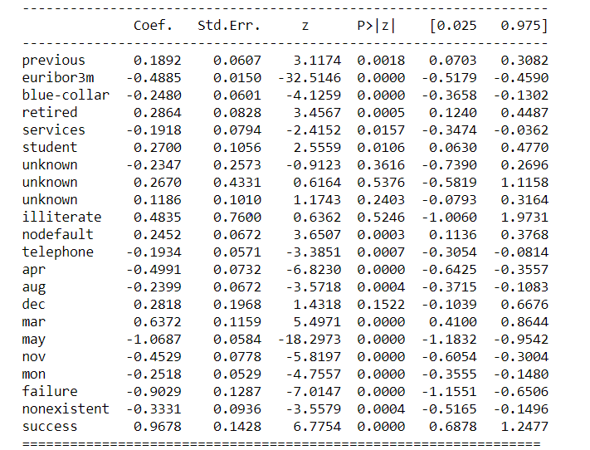
Best Variables

Slide 12
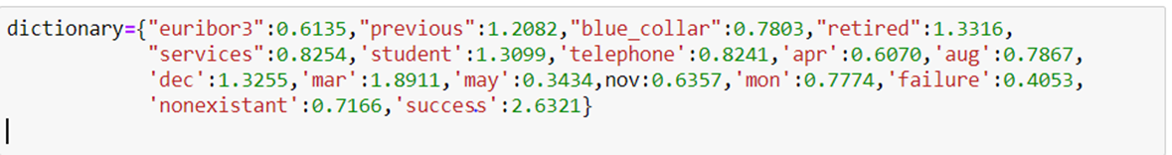
Economic variables- most important is Euro interbank rate.
Every unit increase decreases odds of subscription by (1-0.61) so roughly 40%.
Inference: when the economy is bullish, people are less likely to put their money in the bank. Maybe the optimistic economy increases risk appetite, they would think of investing in more risky investments and not putting their money in a term deposit.
Job category: Of more than 10 categories, with the admin as a reference , blue-collar workers and people in the service industry: decreased odds by about 22%,retired guys and students: increased odds by about 30%
Inference: students and retirees are a great target market for ‘savings’ products. Low risk appetite?
Month: Reference month was June. March has highest odds about 89% higher. First month has highest odds of subscription. Last month Dec is second at about 33% higher than June. Could this mean, most people subscribe at the beginning and end of campaign? Could this be because of other factors like more intense advertising at these periods?
Day contacted: Generally odds for all other days are generally the same, however clients last contacted on Monday:
Lower odds by 23%. Guys don’t like to be called on Monday?
Outcome of previous campaign: success: higher odds by about 200%, failure: lower by about 60%,nonexistent: lower by about 30%

Slide 13
Conclusion
Call clients on any day other than Monday
Focus on previous success’s and clients not targeted before
Focus on best prospects (previous successes and non-targetted) in first month and last month of campaign to increase magnitude of success
When economy is very optimistic, bank should try and market more high risk products? This is interpreting the inverse relationship between high euro inter bank borrowing rate, and term deposit – generally a low risk investment

